Slide 1
Impact of Lockdown on Curbing the Increment of Covid-19
Chi Zhang, Haolin Li, Hongsong Li

Slide 2
Our plan
Using time series model to predict the future trend of covid. (Done)
Based on our predictions as Y, collect information of states as X and fit another model to predict how much an order (such as stay home order) would affect the spread of the virus. (Not working as expected)
Using results from our model to give suggestions to state governments.

Slide 3
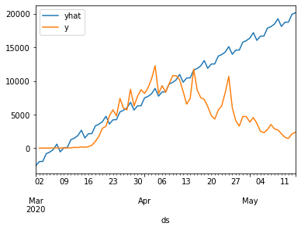
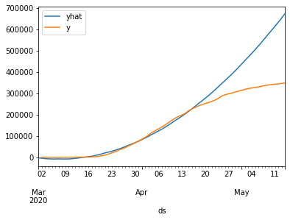
FBProphet
New York state started lockdown on March 28th.
Training data: 2020-03-01 to 2020-04-15
‘yhat’ stands for predicted value, ‘y’ stands for ground true value
Daily Case Increment
Accumulated Case Increment

Slide 4
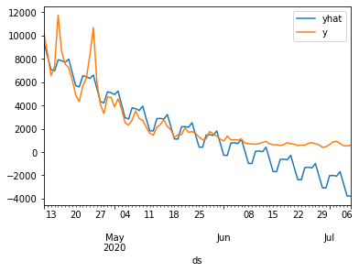
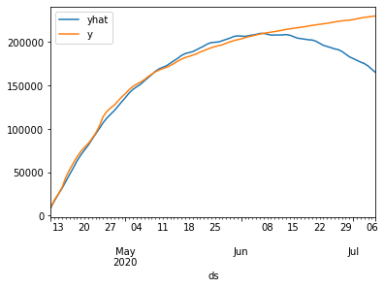
FBProphet
New York state started reopen on June 8th.
Training data: 2020-04-11 to 2020-06-01
‘yhat’ stands for predicted value, ‘y’ stands for ground true value
Daily Case Increment
Accumulated Case Increment

Slide 5
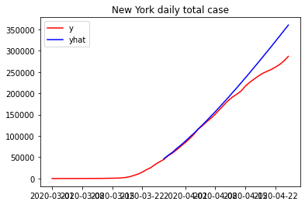
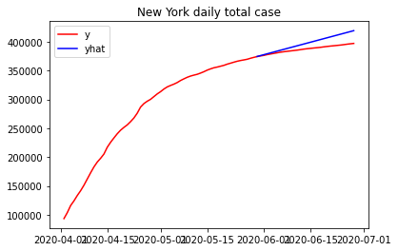
Arima model

Slide 6
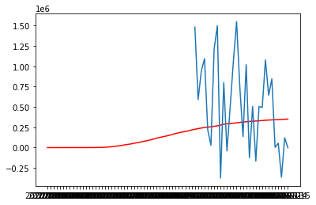
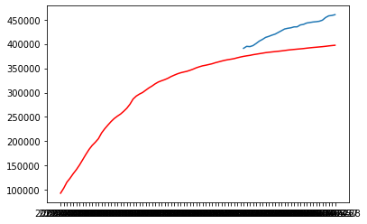
Gluonts model

Slide 7
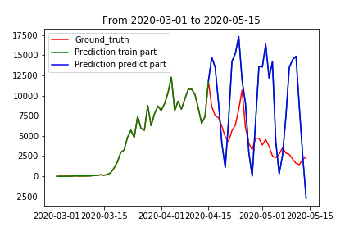
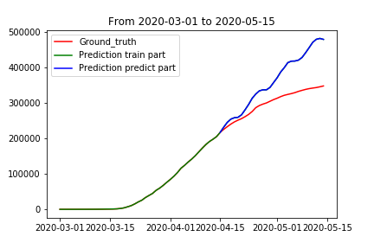
GRU model
Training data: New York data from 3/11/2020 to 4/15/2020
Daily Case Increment
Accumulated Case Increment

Slide 8
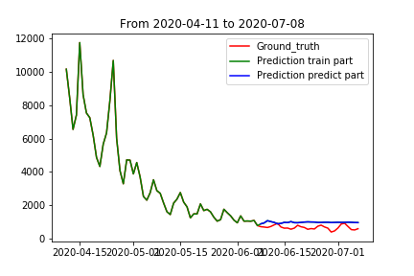
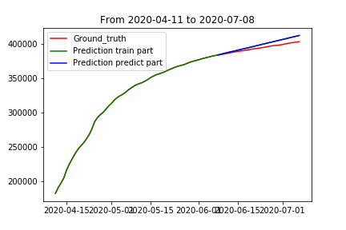
GRU model
Training data: New York data from 4/11/2020 to 6/08/2020
Daily Case Increment
Accumulated Case Increment

Slide 9
Step two

Slide 11
Using time series model to predict the future trend of covid.
Based on our predictions as Y, collect information of states as X and fit another model to predict how much an order (such as stay home order) would affect the spread of the virus. (Not working as expected)
Using results from our model to give suggestions to state governments.
step1
analysis
step2
analysis
step3
Analysis step1 result
Analysis step 2 result and prepare step3

Slide 12
Conclusion
The time series model could make accurate predictions about the spread of the virus if without human intervention.
The stay at home order(and other orders) is indeed effective but the level of effectiveness depends on different states.
Gluonts model may not work if the training data is small and prophet works the best in our experiments.

